Slide 1






Slide 2

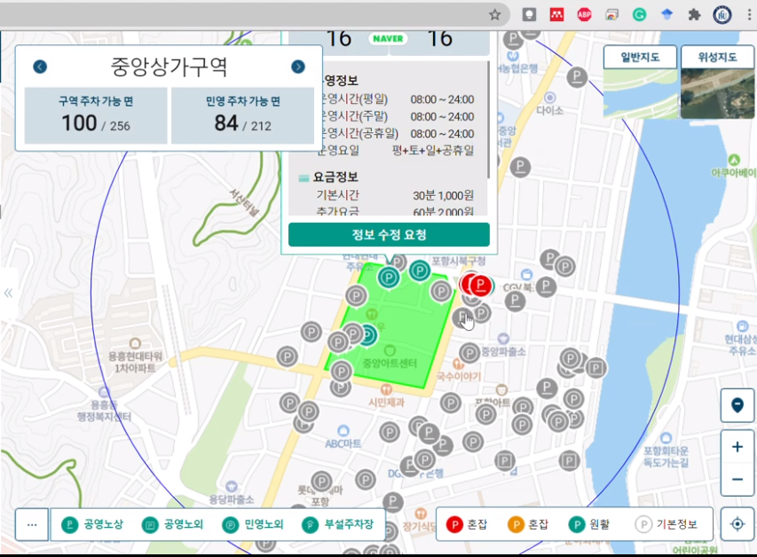

Slide 3





Slide 4




Slide 5
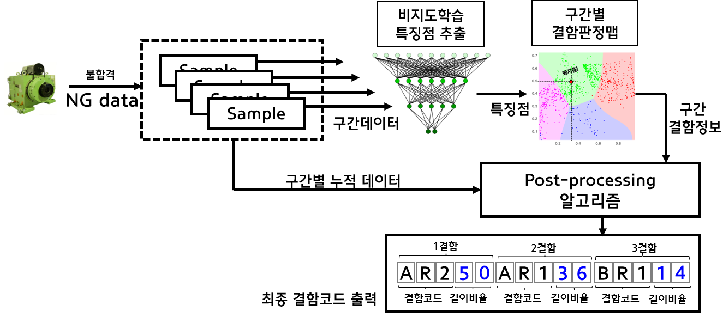

Slide 6
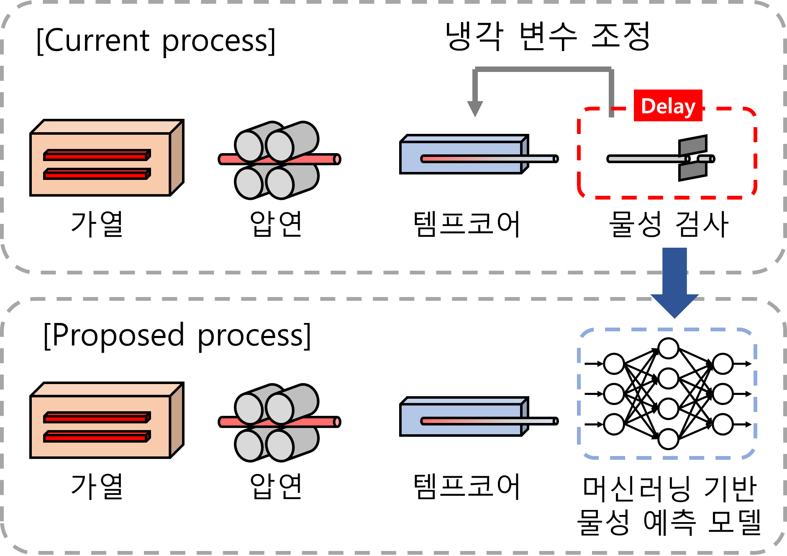

Slide 7
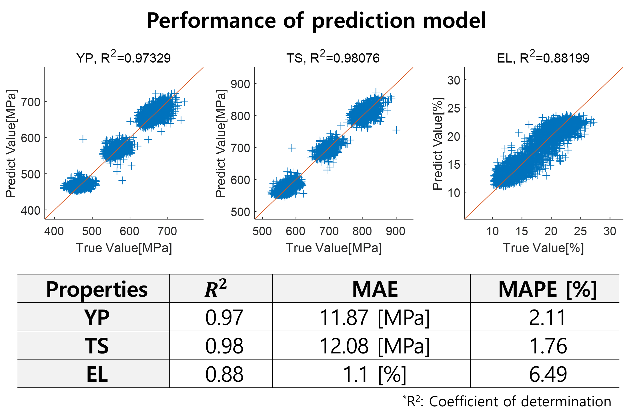

Slide 8
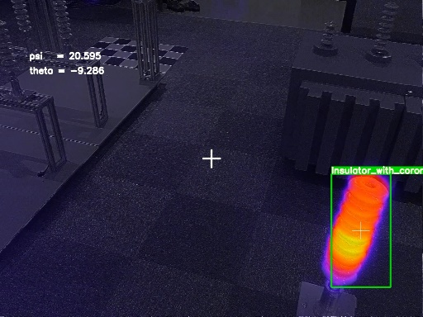
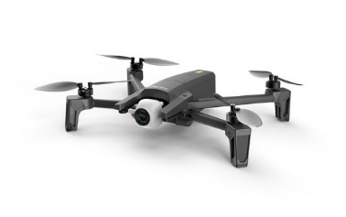
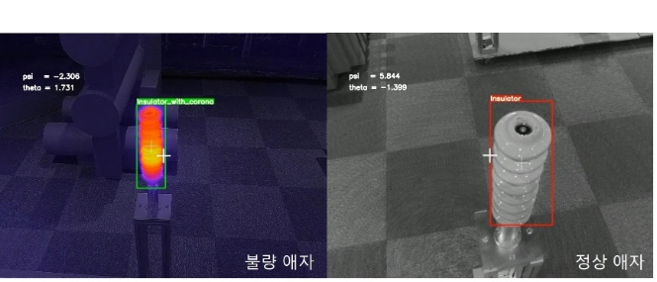
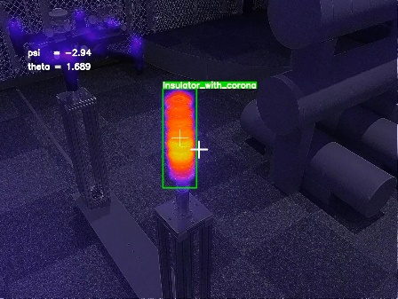
구분 | Pitch | Yaw
시선각 오차(RMSE) | 0.94º | 1.74º
[영상기반 시선각 오차 분석 결과]
[애자검출 탐지 결과]

Slide 9
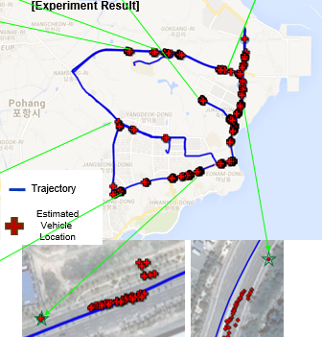
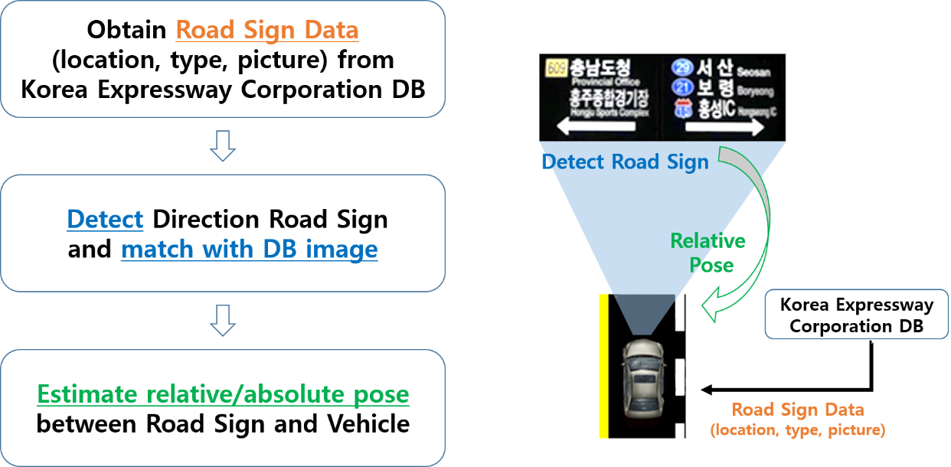
Vehicle localization with Sign Post
Proposed Vehicle Pose Estimation Algorithm
DB
Obtain corresponding points
between {IM} and {S}
Relative pose
between {C} and {S}
Transform point in {S} to
UTM coordinate{U}
Video
Road sign
detection
Corner
detection
Feature
Matching
Non-linear least square
pose estimation
Coordinate Transformation &
GPS to UTM conversion

Slide 10
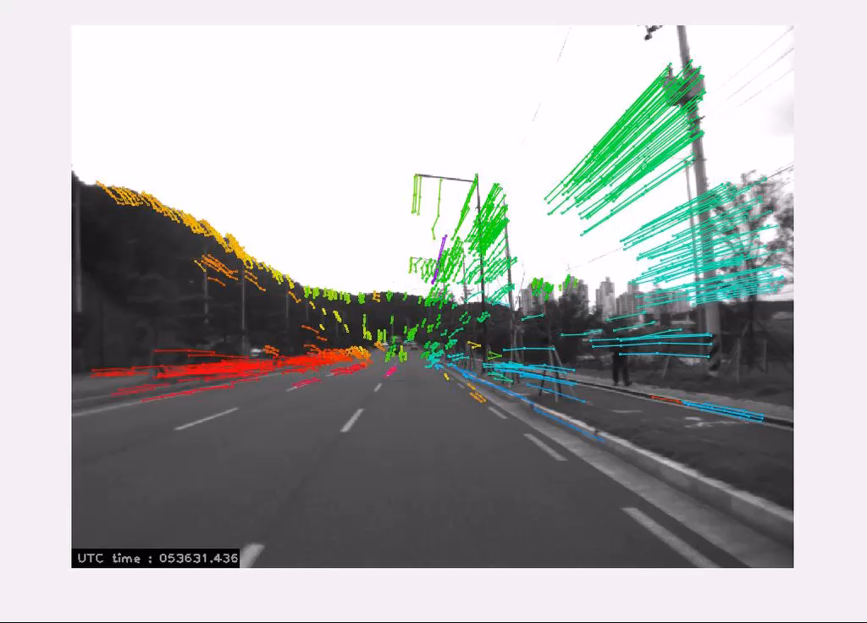
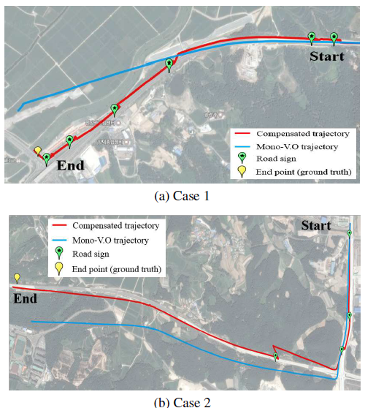
Current Research
4. Visual Odometry – Drift Compensation

